Slide 1
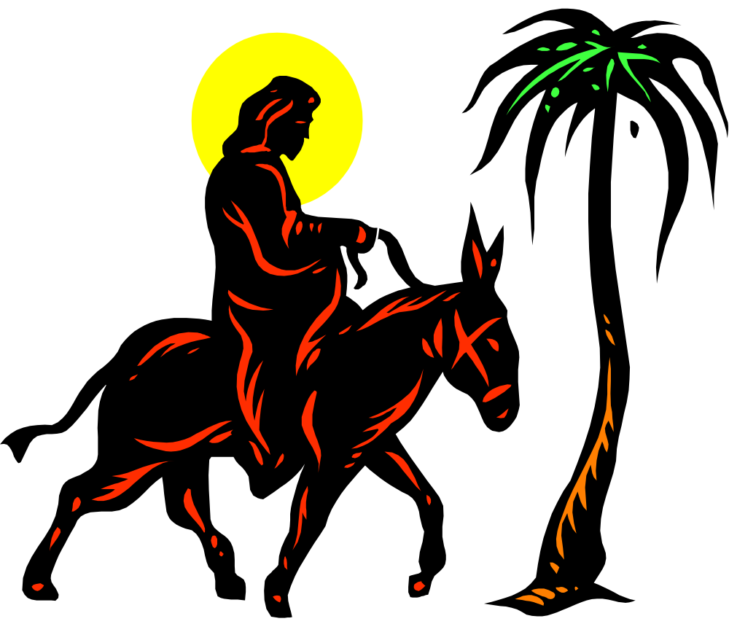
JESUS IS COMING
Matthew 21:1-11

Slide 2

Jesus Comes With Careful Preparation.
Zechariah 9:9-12

Slide 3
2. Jesus Comes With Great Promise.
Matthew 21:1-7

Slide 4
3. Jesus Comes With Clear Expectations.

Slide 5
Matthew 21: 10-11
10 When Jesus entered Jerusalem, the whole city was stirred and asked, “Who is this?”
11 The crowds answered, “This is Jesus, the prophet from Nazareth in Galilee.”

